Slide 1
ZIMBABWE MIGRATION DASHBOARD MANUAL

Slide 2
CONTENTS
Introduction
Dashboard Sections
Charts
Filters

Slide 3
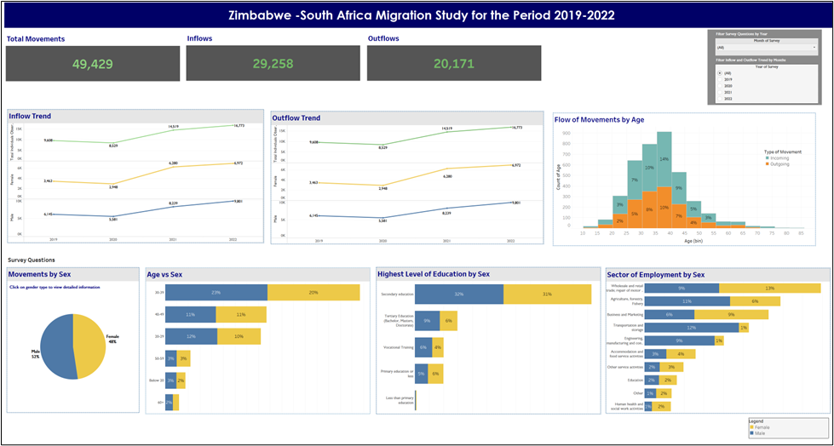
INTRODUCTION
The purpose of this dashboard is to provide audiences involved in drafting policy on migration with up-to-date information near real-time information on migration patterns that are occurring between Zimbabwe and South Africa. The data presented in this dashboard will be used to provide evidence-based data to inform policymakers and advisors to the relevant Ministries.

Slide 4
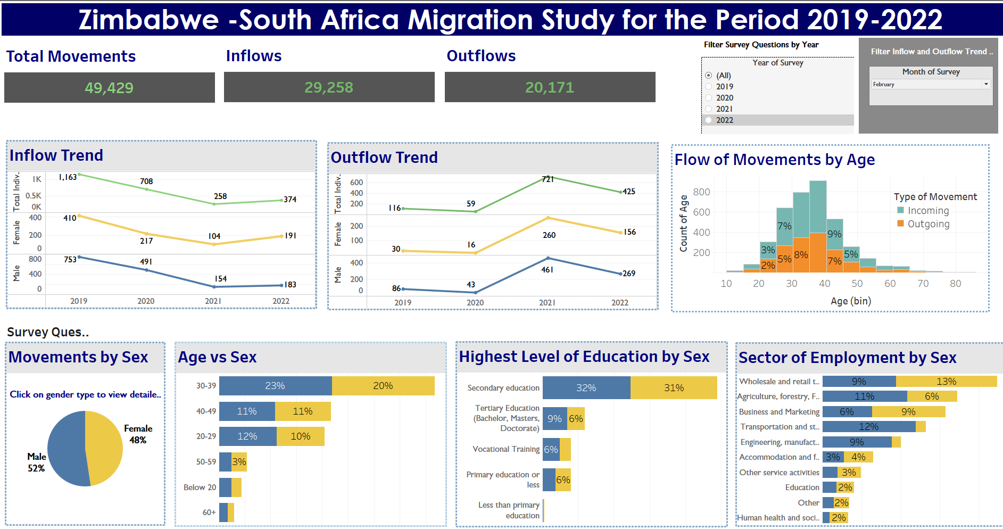
SECTIONS
The dashboard is divided into three main sections. The Header Section, the Trends section, and the Survey Questions section. The sections differentiate the types of data that are presented. The reader begins with the header section and navigates to the trend section and finally to the survey question section. The dashboard is read from top to bottom.
Header Section
Trends Section
Survey Questions Section

Slide 5
SECTIONS Cont..
The dashboard also contains filters to help audience to undertake their own data exploration. The two filters include a month filter, and year filter.
Filter

Slide 6
SECTIONS Cont..
The dashboard has a legend depicting the colours used to show the different genders. Male is represented as blue, while females are represented in yellow.
Legend

Slide 7
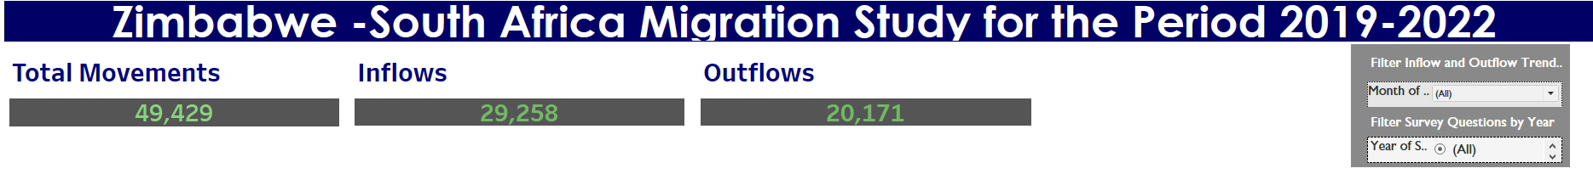
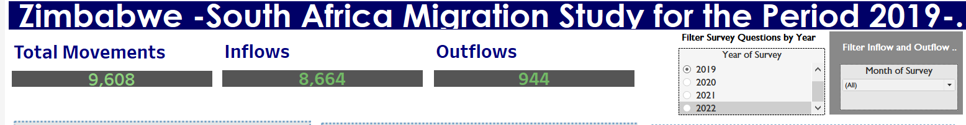
Header Section charts
The header section charts contain information on the Total Movements recorded during the period. The total movements, inflow and outflow figures are cumulative figures. ​
The Year filter can also be used to show movements for that exact period. In the image below the year 2019 was selected. The total movements recorded for that period were 9,608, Inflows 8,664 and Outflows 944.

Slide 8
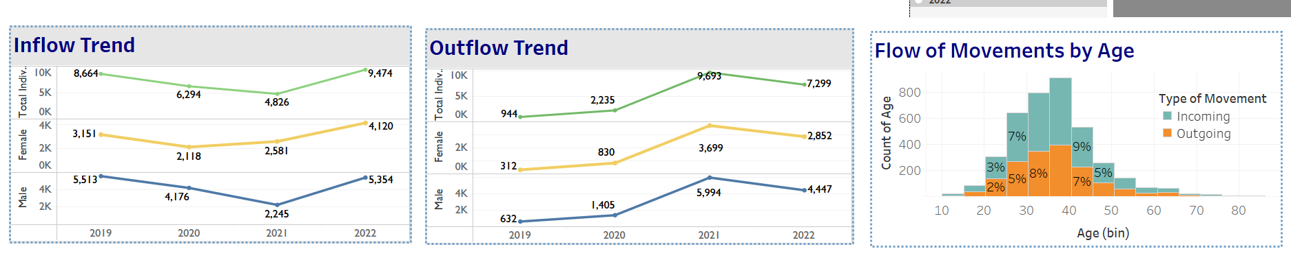
trend Section charts
The trend section charts shows information on the movement trends that occurred during the reporting period. The section consists of three charts, the inflow trend (inflows into Zimbabwe), outflow trend (outflows out of Zimbabwe) and age distribution by flow type. The total movement line is depicted in green in the Inflow and Outflow trend chart, with movements by females in yellow and movements by males in blue. This corresponds with the legend in the bottom right corner of the dashboard.

Slide 9
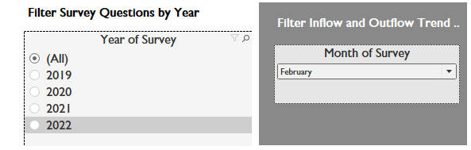
trend Section charts
The trend section charts can also be drilled down for further data exploration. The months filter if selected can show movements of that particular month across each trend chart. Allowing for the audience to do a year-by-year comparison.
In the diagram above the month of March has been selected, the output is depicted to the right showing the movements that occurred in March across all the years. Selecting the Year of Survey filter will not make any changes to the Inflow and Outlfow trend chart.

Slide 10
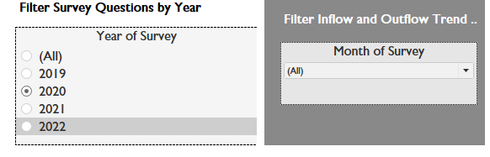
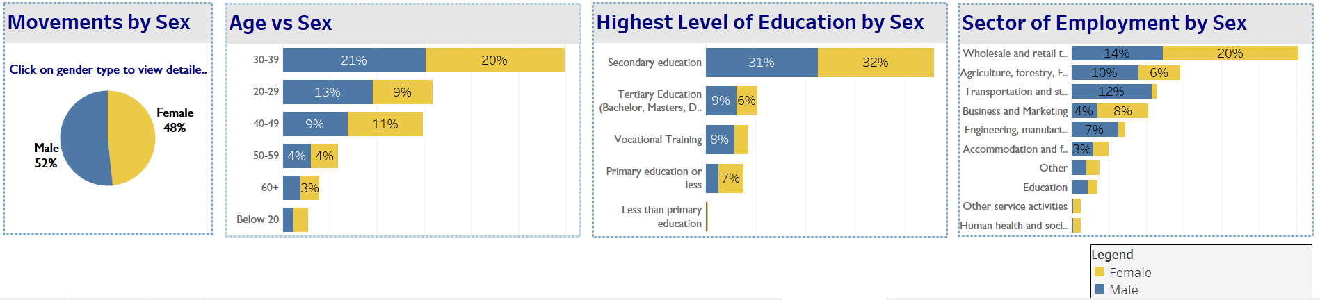
Survey Section charts
The survey question charts, show information pertaining to answers received by field agents through interviews conducted at ports of entry. This section can be filtered using the Year of Survey Filter, to show the varying answers by gender over the years. The below diagram illustrates the responses given in 2020. The month of survey filter does not work on the survey question charts.

Slide 11
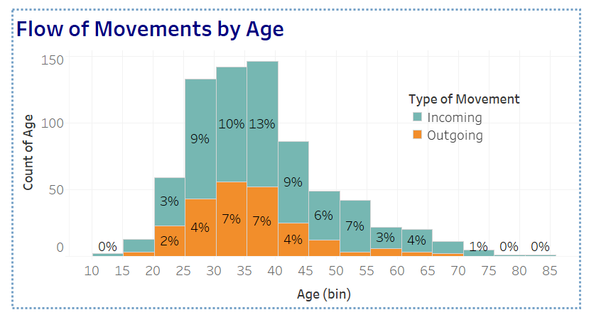
Trend Section charts
The age distribution chart can also be filtered using the Year of Survey filter.

